Slide 1

Futuristic Airbnb – Exploring in London
Image Source :
https://www.axisrooms.com/Airbnb-effect-hotel-industry/
Data 230 - Data Visualization |Saranya Pandiaraj

Slide 2
Introduction
Airbnb is a vacation rental platform where the user can rent a home for tourism experiences.
User can also list their properties in Airbnb for renting it out.

Slide 3
Motivation
To find a better accommodation for the guests in London
To improve host’s business in Airbnb London

Slide 4
Topics covered in this presentation
Data Sources
Data Cleanup and Exploration
Data Visualization
Takeaways

Slide 5
Data Sources
Listings
Reviews
Neighborhoods
Calendar
Insideairbnb.com – London, England, United Kingdom
Sourced from publicly available information in the Airbnb Site
Data Files

Slide 6
Overview of the Dataset
listings.csv
This file contains about the Airbnb Host, listing and Property Information’s. It also contains about the reviews scores & availability details of the property.
reviews.csv
This file contains about the review information of the property.
neighbourhoods.geojson
This file contains the geographical features of the London neighbourhoods having the Airbnb listings.
calendar.csv
This file contains about the Property availability and its price information for the future year.

Slide 7

Data Cleanup and exploration
There were around 76 features in the listings file consisting of various descriptive, categorical, numerical, Boolean, etc. fields.
Below are the few data cleaning process implemented using Pandas and Tableau as part of this Dataset.
Dropping Columns having more than 85% of null values
Similar type of columns having same values
Data type conversion
Similar column values were replaced with the respective values for a better plot

Slide 8
After Cleaning?
There were around 76,534 Airbnb listings in 33 neighborhoods of London
The Average Price of the Listing is £ 113.90
There were around 50,764 distinct hosts
Average Reviews per month was around 31,064
Average Ratings – 4.79

Slide 9
Data visualization
Research Questions based on Guest and Host perspective
Choosing the best property according to our requirements?
Most and Least Expensive time to visit London
Finding the Busiest Month By Listing Availability? When to plan for vacation?
Renting Price based on the Accommodates
Judging the Host Response and Acceptance Rate?
Future Price Prediction?

Slide 10

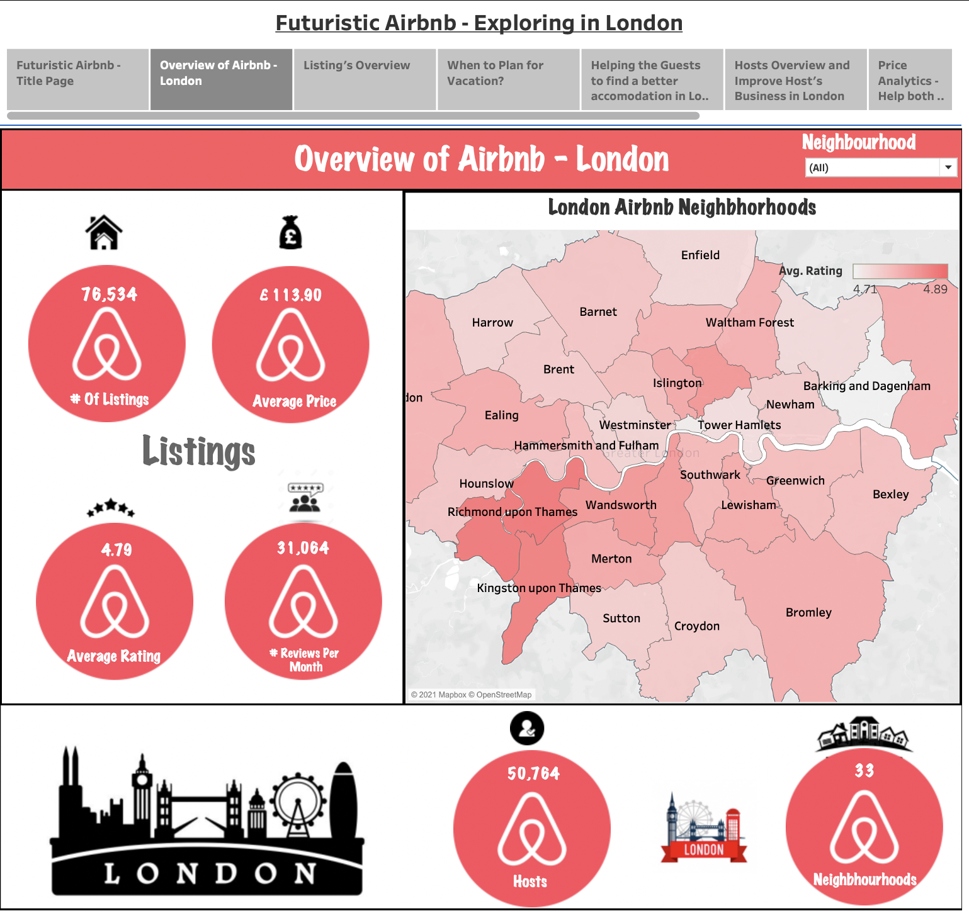
Overview of Airbnb - London

Slide 11
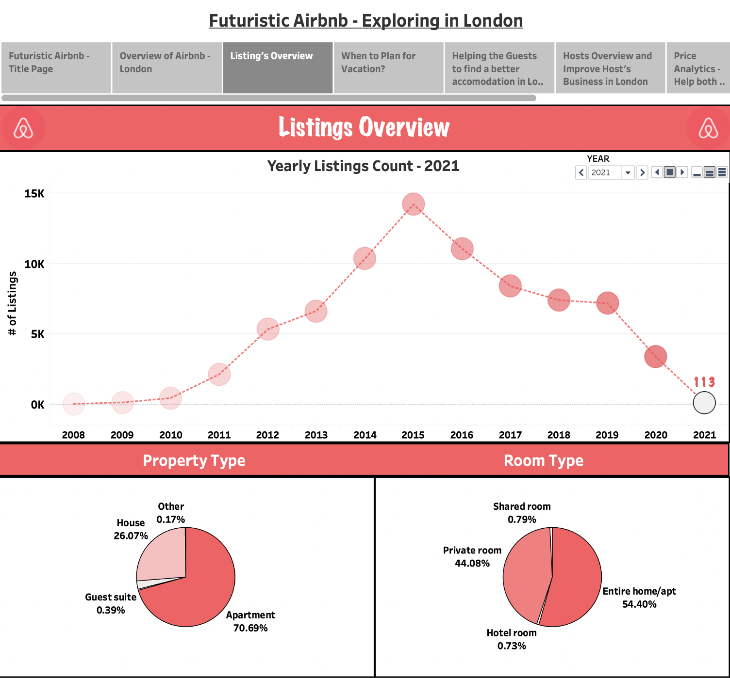
Listings overview

Slide 12
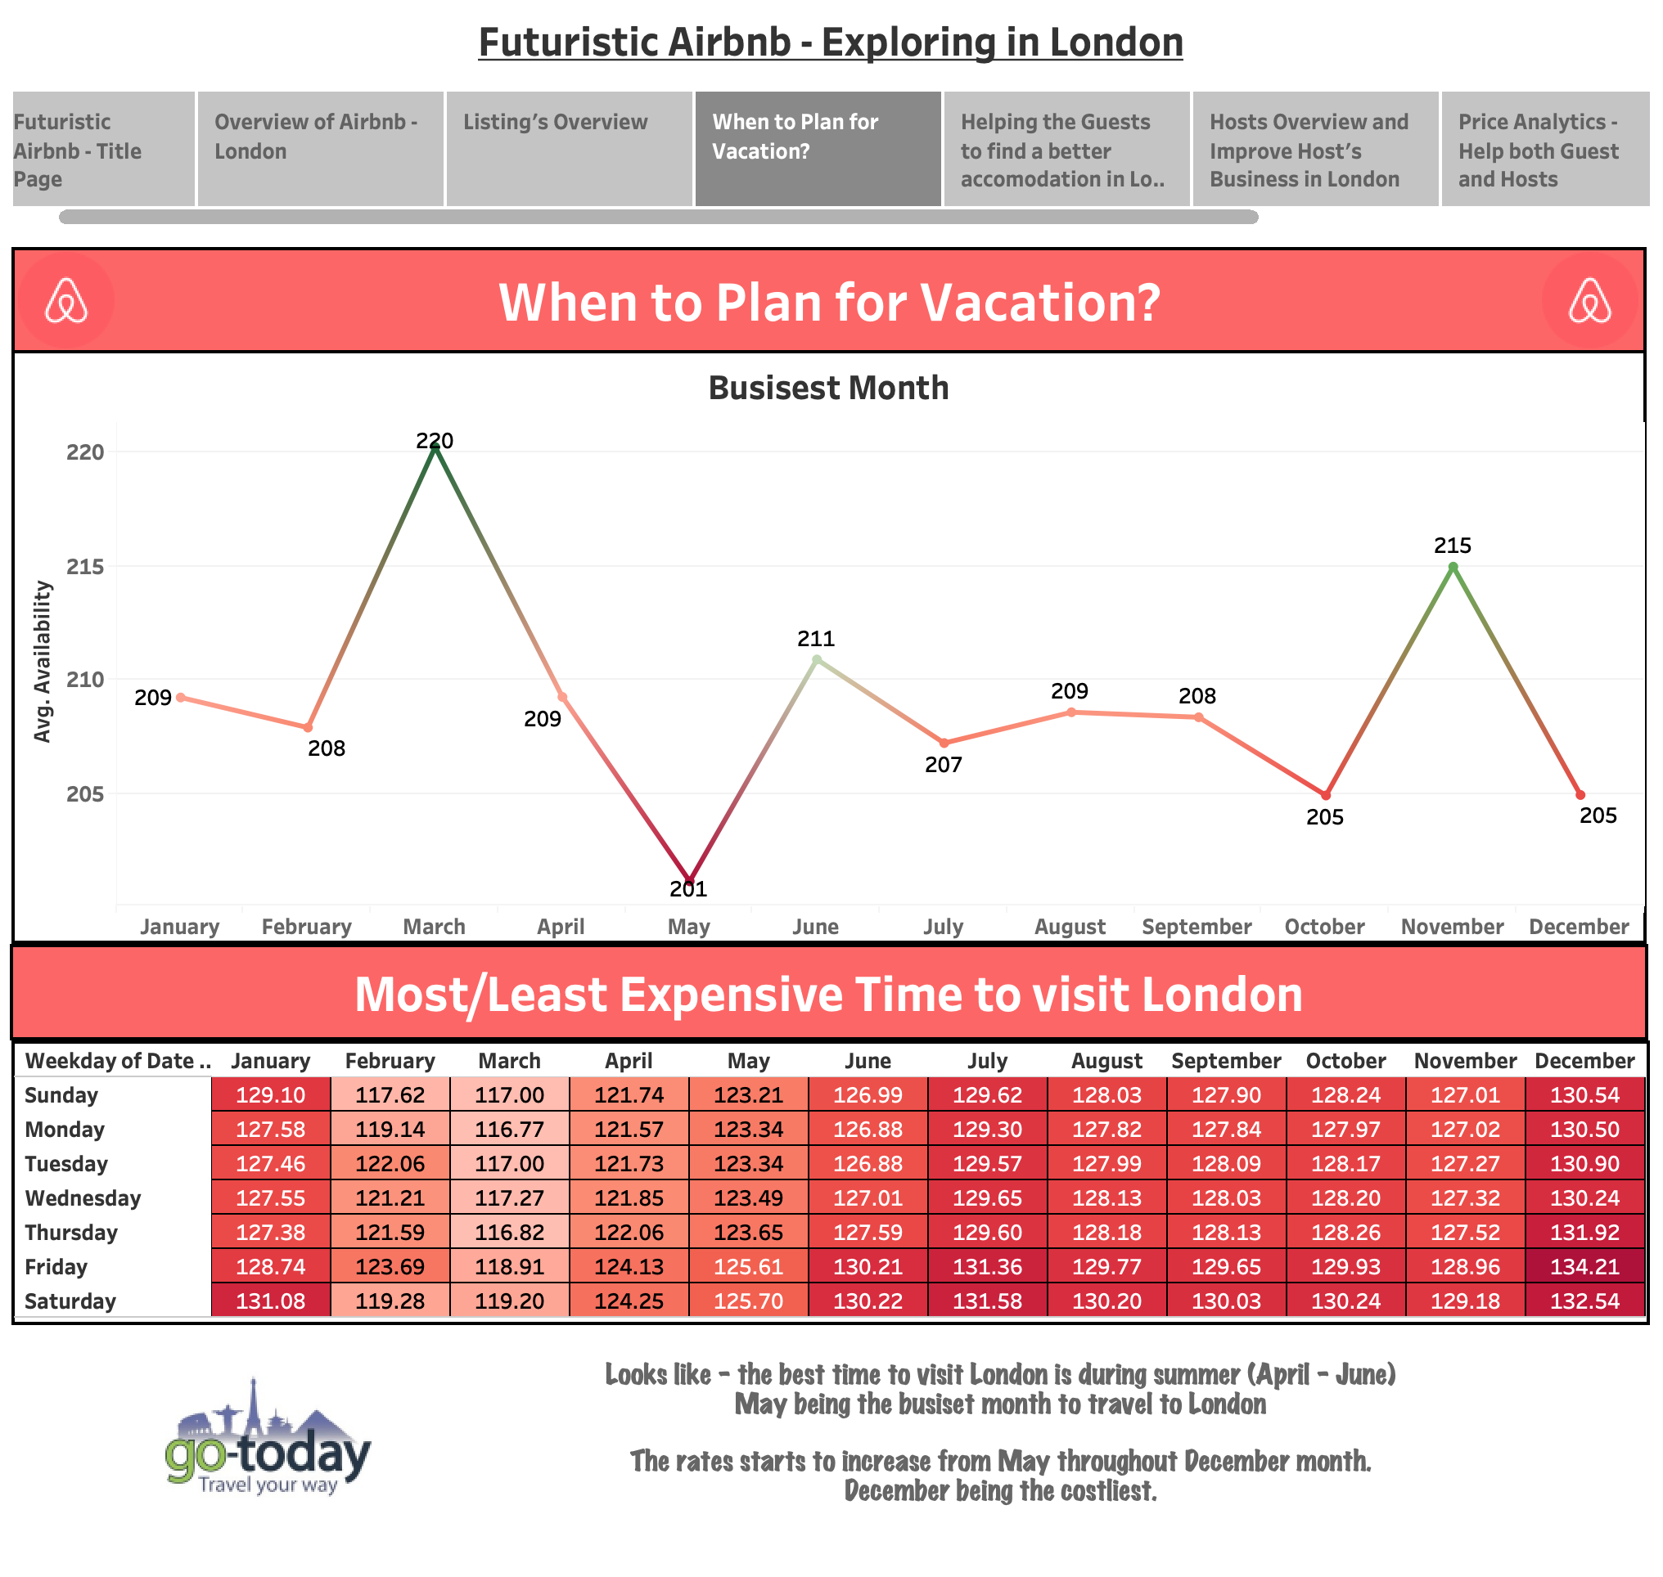
When to plan for vacation?

Slide 13
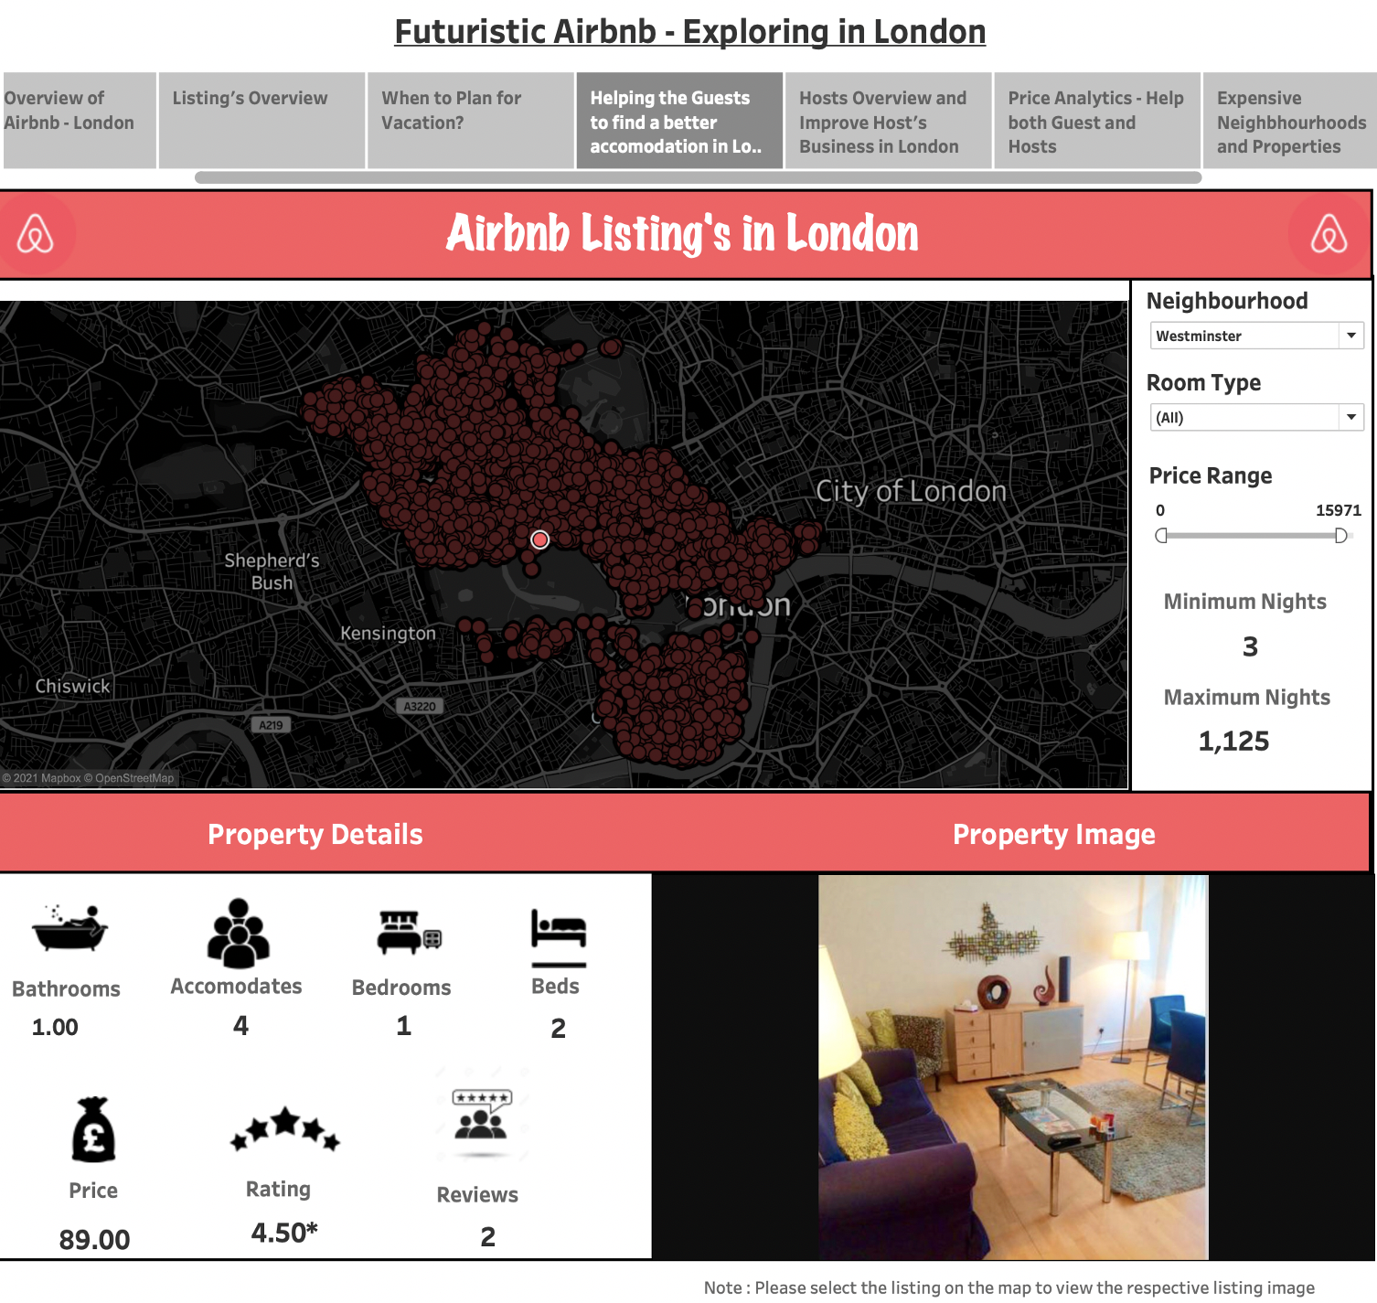
Helping the guests to find a better accommodation in London

Slide 14
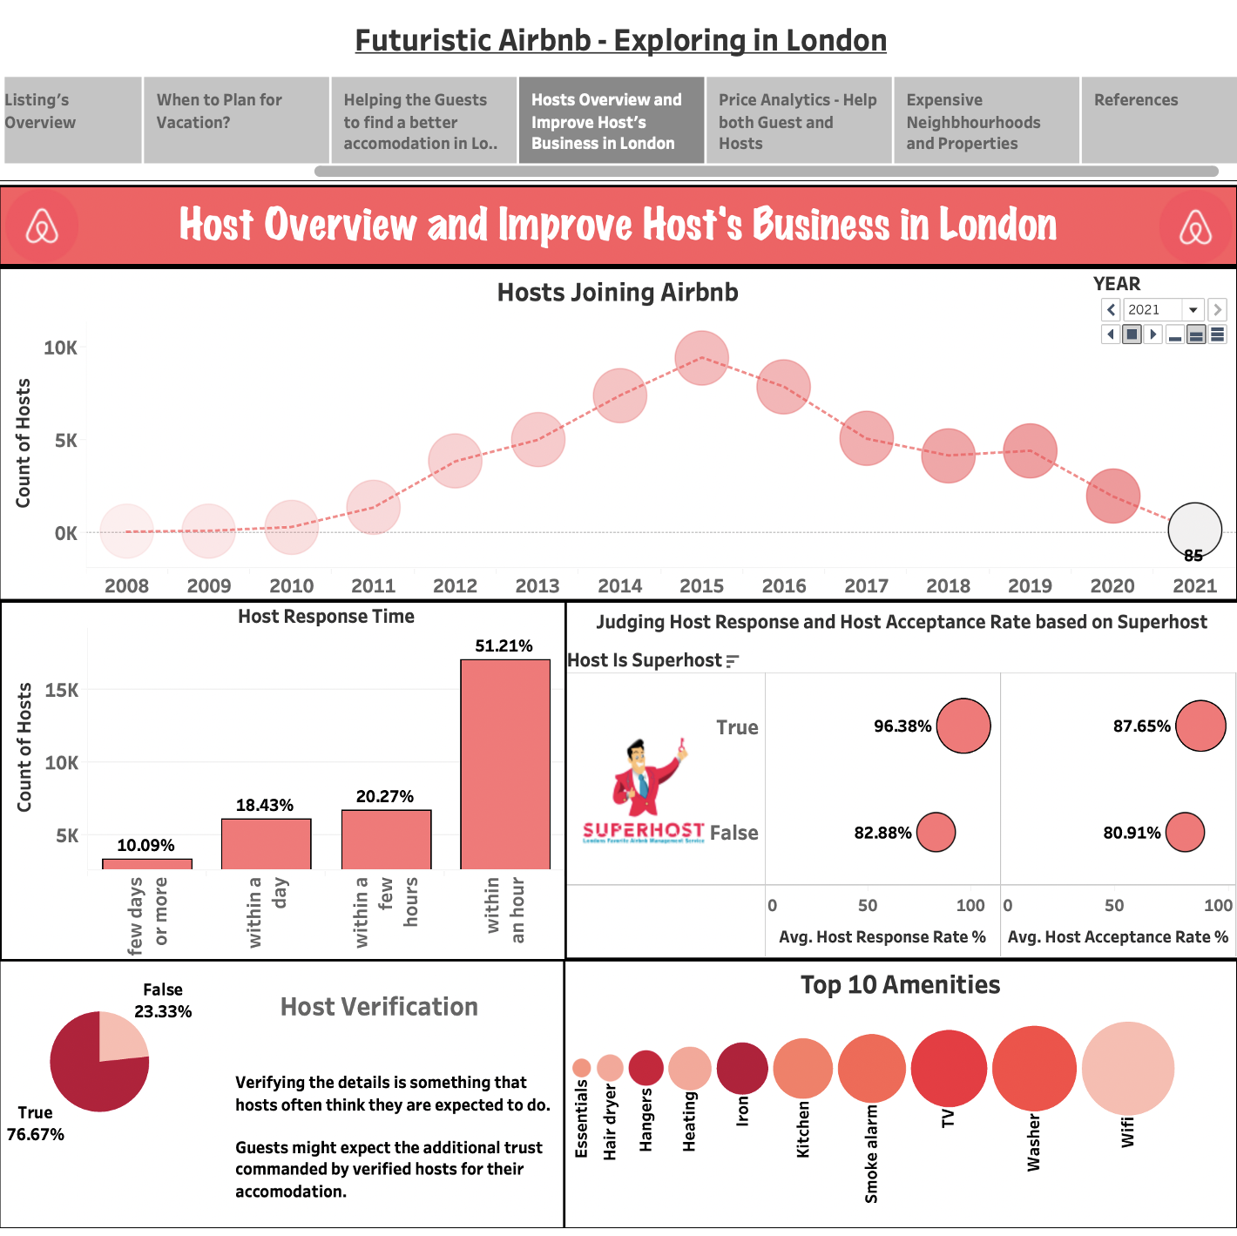
HOST overview and improve host’s business in London

Slide 15
Price analytics – help both the guests and hosts

Slide 16
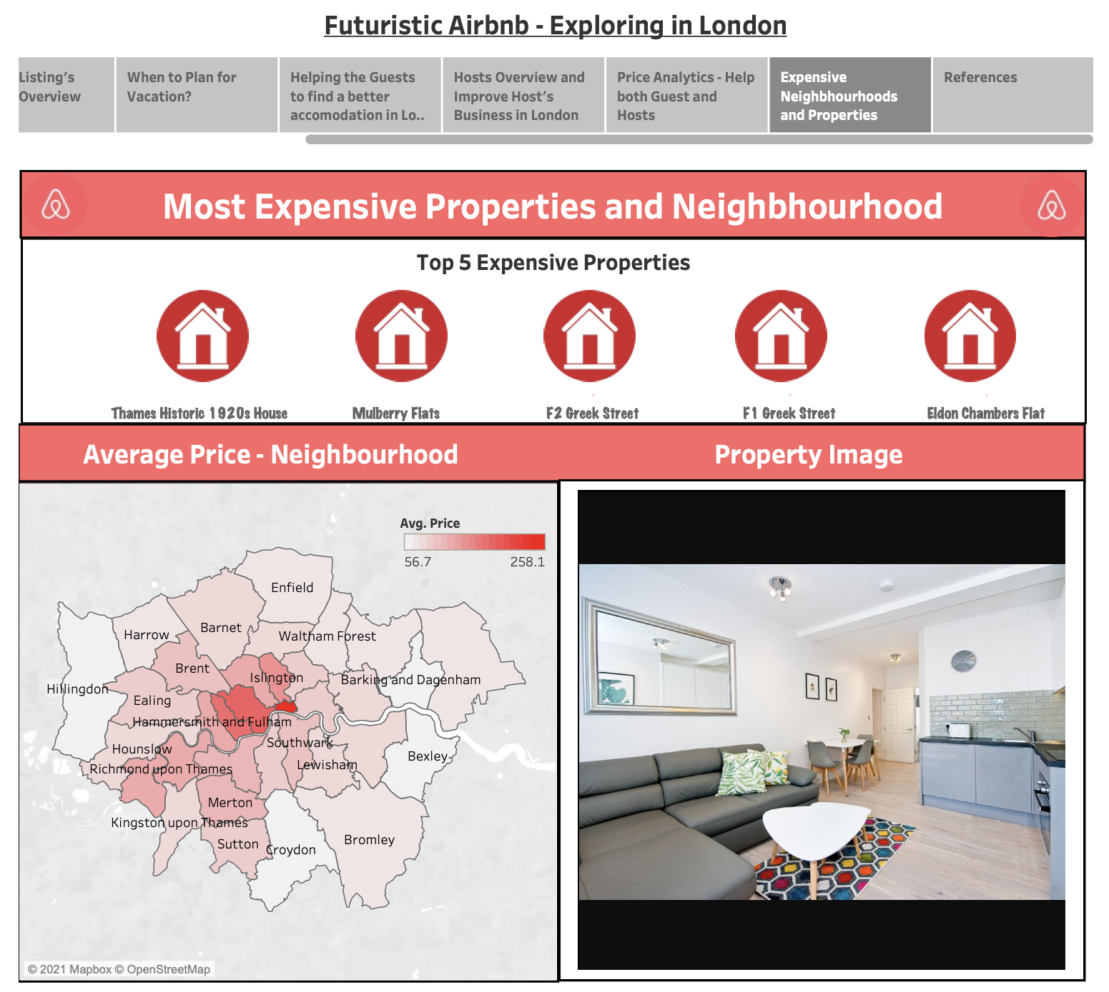
Most expensive properties and neighborhood

Slide 17

Dashboard Demo

Slide 18
Takeaways
From Guest Perspective :
Renting Price based on the Accommodates
Can decide on the rent prices based on the accommodates
Finding the Busiest Month By Listing Availability? When to plan for vacation?
To plan a trip for a cheaper accommodations (time when less people travel)
Best time to visit London (April and May)
Judging the Host Response and Acceptance Rate?
Knowing about the best hosts for ease of communication
Most and Least Expensive time to visit London
December – Costliest , Jan-April (Minimal Rate)

Slide 19
Takeaways
From Host Perspective,
Amenities
Wi-Fi, Heating, Essentials, Kitchen and Washer are the most important amenities to be considered for the successful of listing. For those who are already in the business and don't have those amenities, make sure the facility of installing all or some of the amenities to grow your business
Renting Price based on the Accommodates
Can decide on the rent prices or rent out the property based on neighbourhoods
Judging the Host Response Rate?
For improving their response rate
Future Price Prediction
For the Hosts to set their prices based on the predicted result

Slide 20

CONCLUSION
From the London Airbnb Data we can conclude the below points :
The average price of the listings in London are around the rate of £113.90
The average rating of the listings in London is 4.79 and they get around 31084 reviews per month
The listings count is very less in London considering the current situation because of the pandemic
Most of the property and room type belong to Apartment and Entire Home/apt respectively
The Peak season to travel in London is during their summer season (April and May), where May is the busiest month for travel
The price range of the listings is very high during December month
Using Airbnb’s listing data, it helps the guests to find better accommodation in London
The Hosts joining Airbnb count is very less in London considering the current situation because of the pandemic
Host Response time, Host Acceptance and Response rate are actually good in London Airbnb in the margin of above 80%. Additionally, most of the hosts are verified in the margin of about 77%
The Price change over time is keep on fluctuating in London. The future price prediction is also high in the case of apartments.

Slide 21
FUTURE WORK
Covering more countries to know the actual Airbnb business strategy
Work on reviews texts by generating word clouds to know what the customers are thinking about it?
To determine the future predictions based on the neighbourhoods
To implement more design principles as discussed in the class

Slide 22

References
Dataset Resource:
http://insideairbnb.com/get-the-data.html
Dashboard Design Resource:
https://help.tableau.com/current/pro/desktop/en-us/buildmanual_shelves.htm
https://help.tableau.com/current/pro/desktop/en-gb/actions.htm
https://help.tableau.com/current/blueprint/en-us/bp_visual_best_practices.htm
https://senturus.com/blog/tableau-dashboard-design-10-best-practices/
https://www.tableau.com/learn/articles/data-visualization-tips
https://help.tableau.com/current/pro/desktop/en-us/what_chart_example.htm
Image Source:
(Dashboard Title Page) https://www.axisrooms.com/Airbnb-effect-hotel-industry/
(Icons Used) Google Search In images and inbuilt PPT templates
General References:
https://www.airbnb.co.in/
https://en.wikipedia.org/wiki/Airbnb

